Slide 1
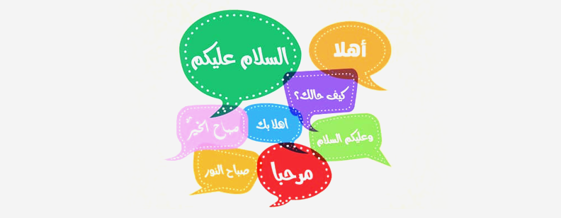
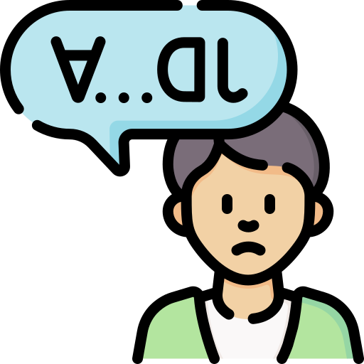
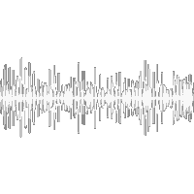
Rehabilitation of Speech Impaired-Persons
for Arabic Language Speakers
أ ... ل ي د
Supervised by:
Dr. Ahmed Hisham Kandil

Slide 2
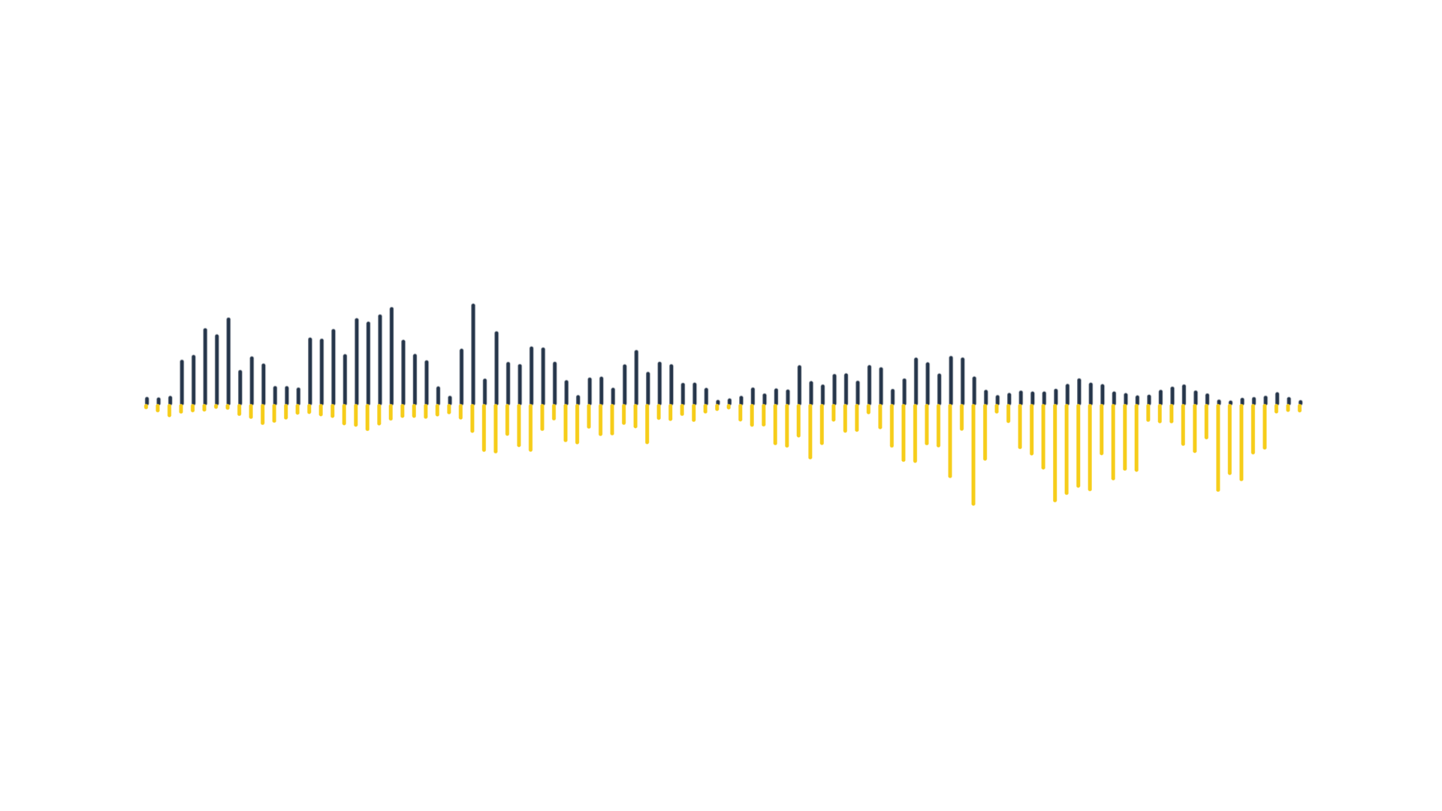
Problem vs. Solution
Outlines
Market & Stakeholders
Product & Services
Methods
Challenges
Conclusion & Future Work
Notes:
What we are going to talk about

Slide 3
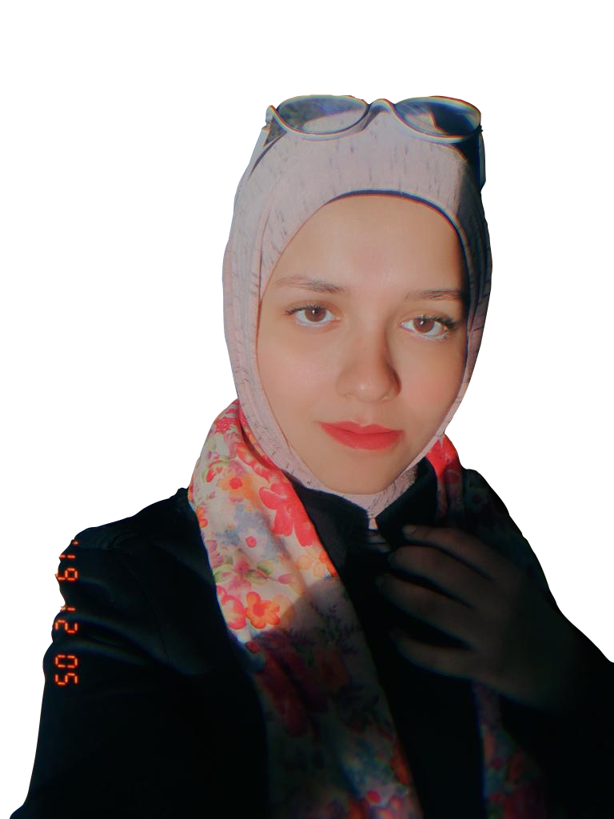
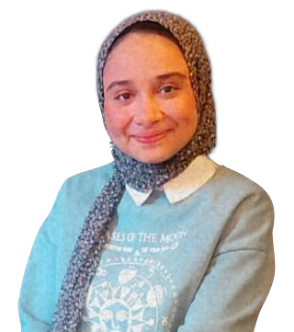
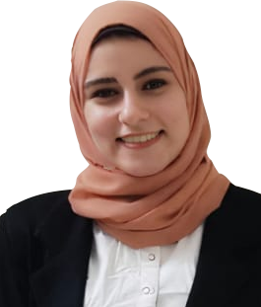
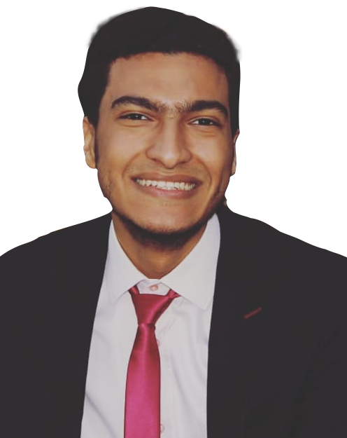
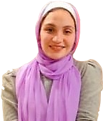
Who We Are …
داليا لطفى عبدالحى
رضوى سعيد محمدى
ميار طارق
طارق محمد رشاد
اميره يحيى انور
Notes:
Who we are ?!
We are a team of biomedical engineering students and we are here to talk about our solution

Slide 4

What is the main problem?!
Problem
Solutions
App
Method
Future

Slide 5
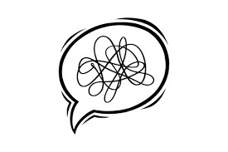
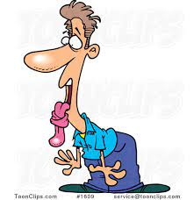
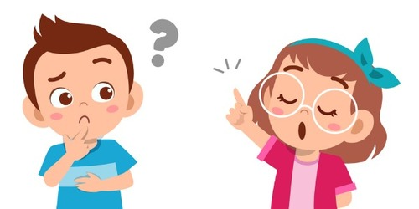
We all know how difficult it can be if you struggle to express your thoughts in speech
Notes:
We all know how difficult it can be if you struggle to express your thoughts in speech
It’s a serious thing, it can be more harmful as the years go
We all must know anyone who has speech problem
so that we decided to find a technical solution to help those people to express they needs

Slide 6
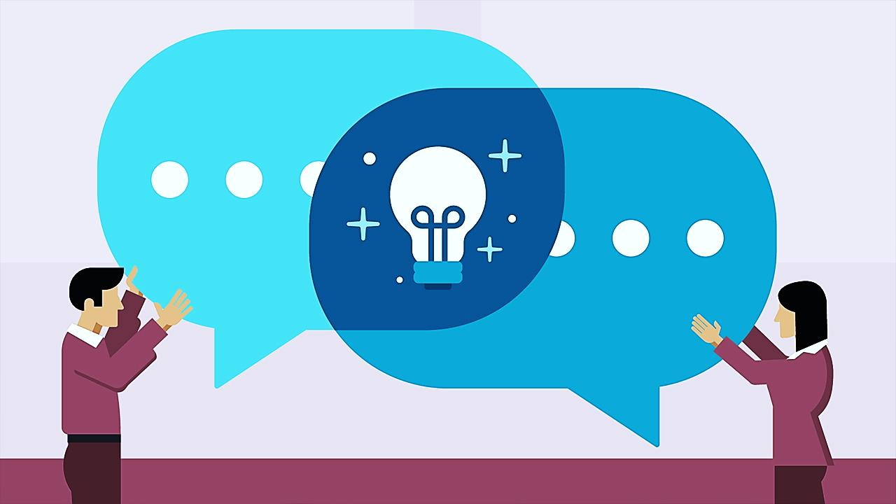
A large part of our communicative capacity depends on speech.
Notes:
Communication is essential for the development of the human being.
And a large part of our communicative capacity depends on speech.

Slide 7
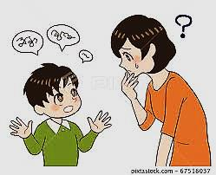
30.8% of the children in Egypt suffers speech disorders
Identification of communication disorders among Egyptian Arabic-speaking nursery schools’ children - ScienceDirect
Notes:
We found that the number of people with speech disorders is relatively large
about 30.8% of the children in Egypt suffers speech disorders due to published research called (Identification of communication disorders among Egyptian Arabic-speaking nursery schools’ children)
Identification of communication disorders among Egyptian Arabic-speaking nursery schools’ children - ScienceDirect

Slide 8
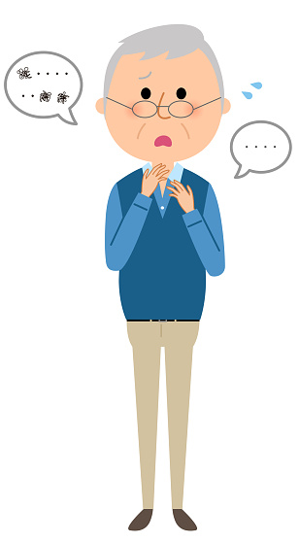
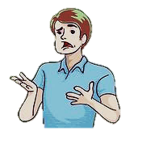
Cases of speech disorders in individuals
Apraxia
Stroke
Articulation disorders &
Fluency disorders.
Notes:
Beside children, many people suffer from speech disorder due to medical conditions like:
autism(توحد), Attention Deficit Hyperactive Disorder (ADHD)(مريض فرط الحركه), oral cancer, strokes (اصابت مناطق النطق), dementia(الخرف), Alzheimer can spur speech disorders in individuals.
Aphasia. People with aphasia can have difficulty reading, writing, speaking and understanding language. The condition can develop when areas of your brain that process language are damaged by stroke or injury.
Dysarthria. Sometimes, the muscles that control your speech become weak due to stroke, multiple sclerosis (MS), amyotrophic lateral sclerosis (ALS) or other nervous system disorders. People with dysarthria may have slow or slurred speech.
Apraxia. People with apraxia know what they want to say, but have trouble forming the words. They may have trouble with reading, writing, swallowing or other motor skills.(Dementia)
Expressive disorders. People with expressive disorders may have difficulty getting words out or conveying their thoughts. Expressive disorders are linked to stroke or other neurological events, developmental delays or hearing loss
Cognitive-communication disorders. When the area of your brain that controls your thinking ability is damaged, it can result in difficulty communicating. People with cognitive-communication disorders may have issues with listening, speaking, memory and problem-solving.
Alzheimer)

Slide 9
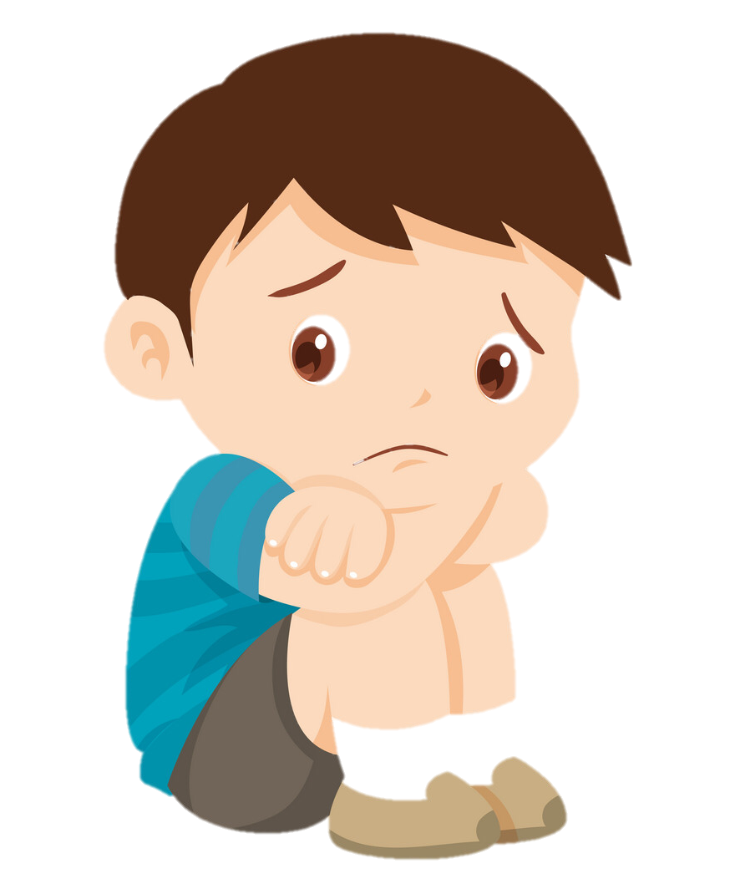
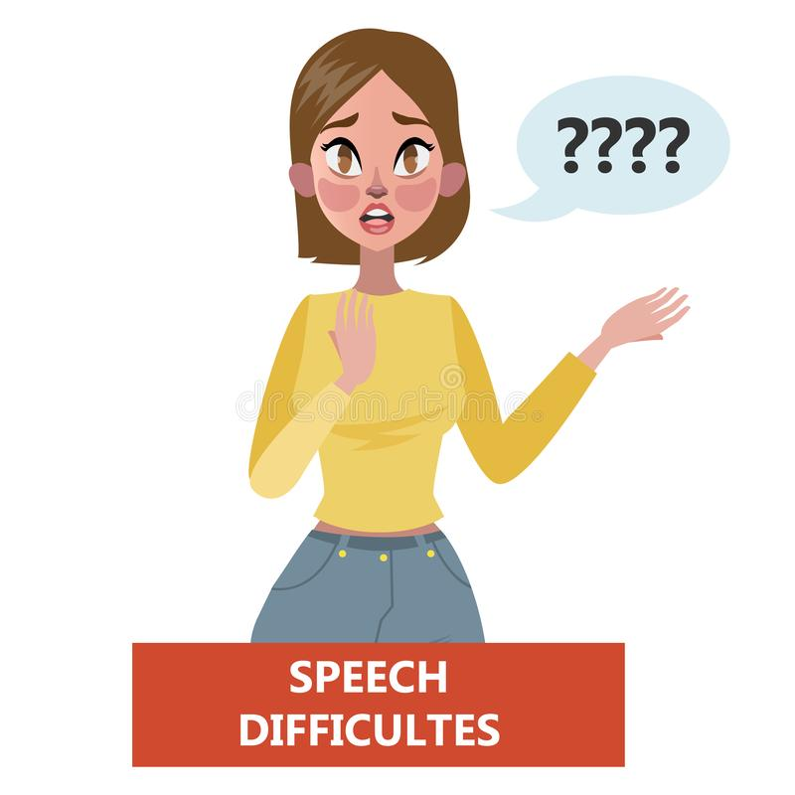
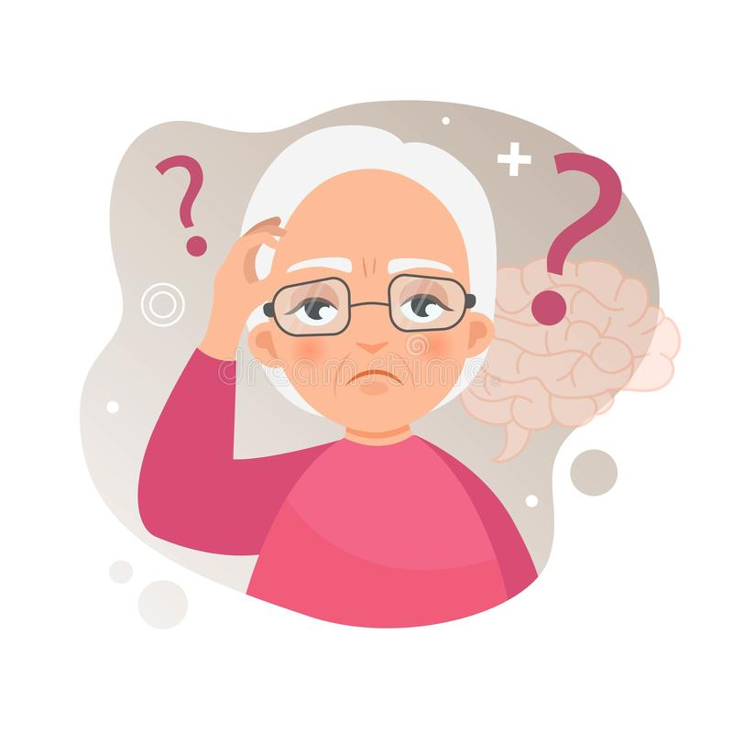
Cases of speech disorders in individuals
Receptive disorders
Alzheimer
Oral Cancer
Notes:
Beside children, many people suffer from speech disorder due to medical conditions like:
autism(توحد), Attention Deficit Hyperactive Disorder (ADHD)(مريض فرط الحركه), oral cancer, strokes (اصابت مناطق النطق), dementia(الخرف), Alzheimer can spur speech disorders in individuals.
Articulation disorders. Children with articulation disorders are unable to produce certain word sounds. For example, they may substitute one sound for another — like saying “wed” instead of “red” or “thith” instead of “this.” Early intervention speech therapy can help with articulation disorders.(ADHD)
Fluency disorders. Fluency disorders disrupt the speed, flow and rhythm of speech. Stuttering (speech that’s interrupted or blocked) is a fluency disorder. So is cluttering (speech that’s merged together and fast).
Resonance disorders. Conditions affecting your oral or nasal cavities may block airflow and alter the vibrations responsible for sound. Resonance disorders are linked to cleft palate, swollen tonsils and other conditions that affect the structure of these body parts.(Oral cancer)
Receptive disorders. People with receptive disorders have difficulty comprehending or processing what others are saying. As a result, they may have a limited vocabulary, trouble following directions or they may seem uninterested in conversation.(Autism)

Slide 10
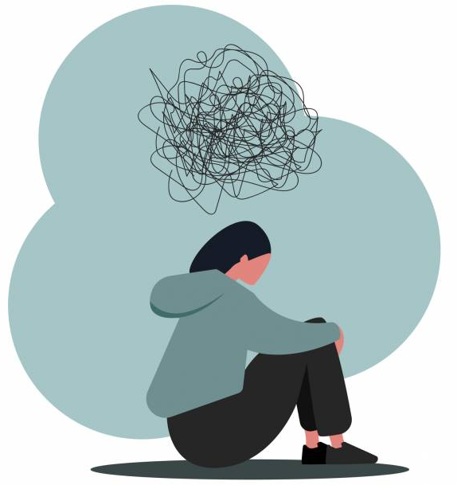
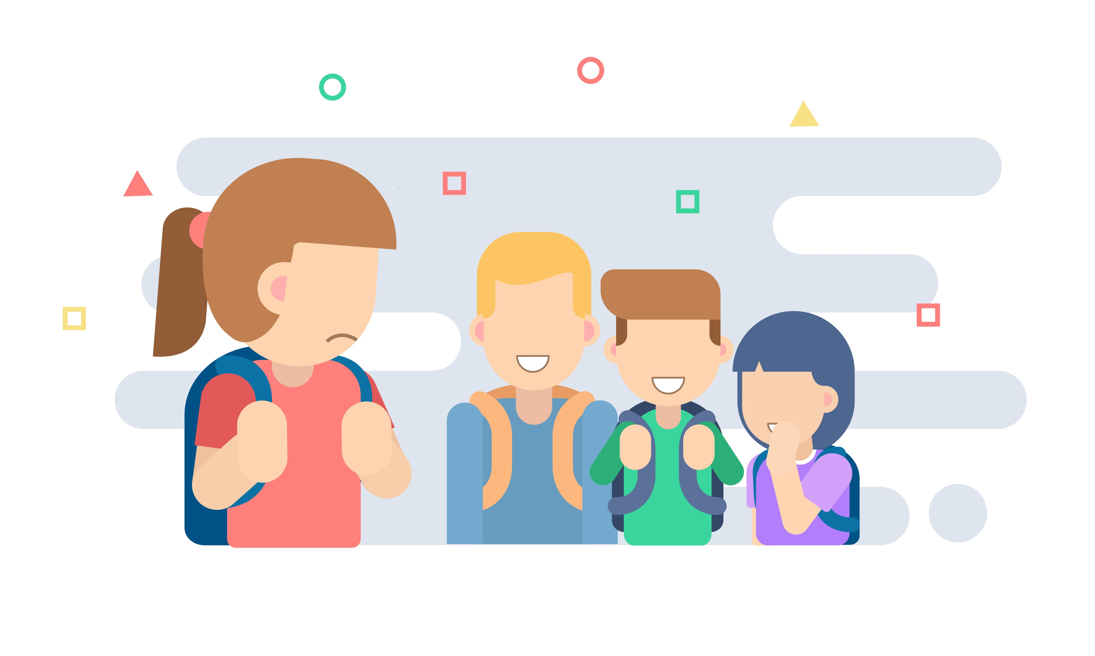
speech is not totally understandable
psychological issues
lose self-confidence
not able to deal with society
Notes:
People having problems in pronouncing some letters are facing many challenges as their speech wouldn't be totally understandable and that may cause psychological issues as they will lose self-confidence and will not be able to deal with society anymore as they will be vulnerable to bullying

Slide 11
Solutions …
Problem
Solutions
App
Method
Future

Slide 12

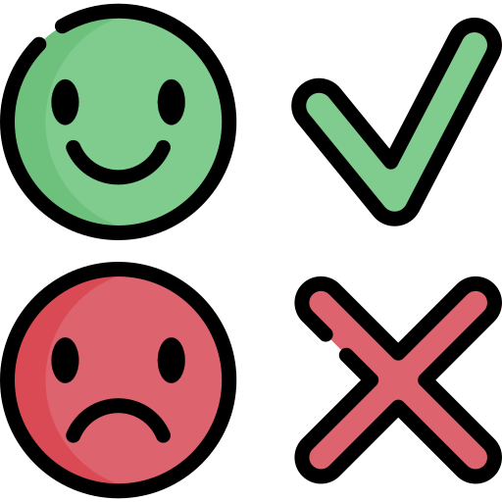
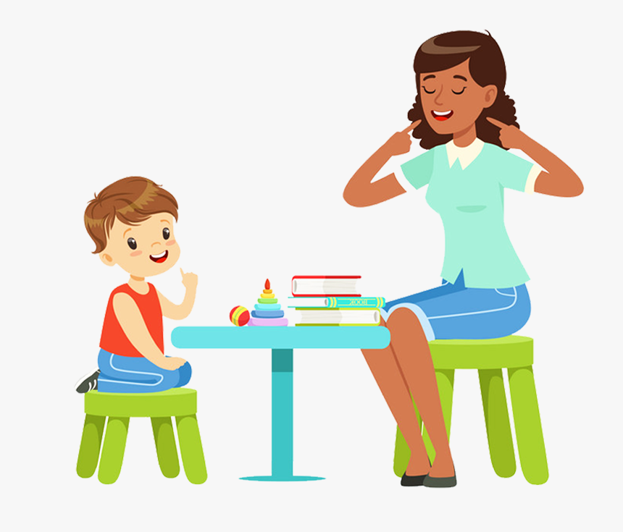
Speech Therapy
Therapists help the patient to recognize his problem and communicate ways
Cost
Waste of time
Boring for (Patient, Therapist)
أاا .. م
Notes:
Patient can go for speech therapy where he will be guided about the different exercises.
Pros: Therapists help the patient to recognize his problem and communicate ways by which he can increase his self-esteem and do away with nervousness that comes with Speech Disorder or Speech Impairment.
Cons:
For patients, this is a costly solution, as some people can’t afford sessions costs, especially those who need practicing for a long time
For the therapist, this is waste of time and boring if there isn't an immediate successful result

Slide 13
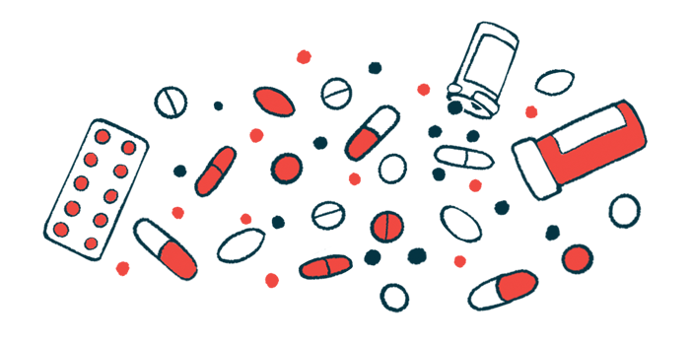
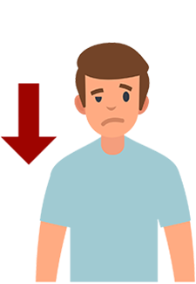
Medications for Treating Speech Disorders
If the cause of disabilities stems from physical factors
Need Practice
Useless
Slow improvement
Lose Interest
Notes:
If the cause of your disabilities stems from enlarged adenoids, vocal polyps, tumors or other physical factors, you might need proper medication.
In some cases, tranquilizers and antidepressants are also prescribed for the individual. In case of severe depression, antidepressants are found to be very helpful.
This also may be a costly solution and useless in some cases. Besides if there is slow improvement the patient would need to practice pronunciation and supervision.

Slide 14
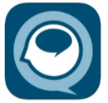

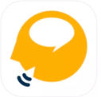
Practicing Pronunciation of Words
Record yourself for playback and correction
Pictures paired
Limited
Arabic not supported
Inconvenient for Some ages
Conversation Therapy
Articulation Station
Apraxia Therapy
Notes:
we can find many apps that help patients to practice pronunciation, but practically these apps have some cons such in some apps only one letter is included for free, or in another app, the trial period is too short to assess whether it’s right for you
also in most of these apps, the Arabic language isn't supported
Some content may not be appropriate for kids
Inconvenient for some ages

Slide 15
What is our Solution ?!
Problem
Solutions
App
Method
Future

Slide 16
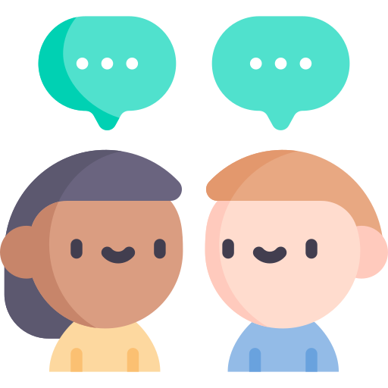

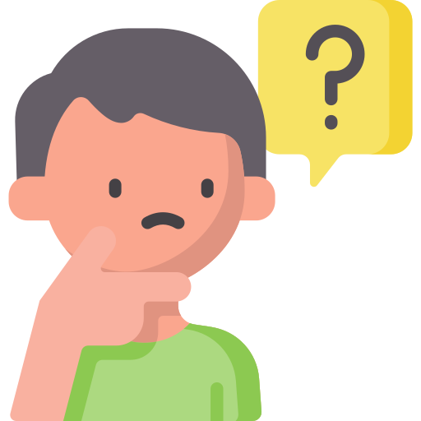
Improve pronunciation
Help for communication
Improve the ability to remember objects, friends, and family members.
Notes:
We decided to develop an app that helps those patients and overcome other apps' cons
Our app is a way to improve pronunciation, communication and the ability to remind both object, friends and family members.
Our application is developed as a rehabilitation tool for stroke, Alzheimer and speech-impaired patients.

Slide 17
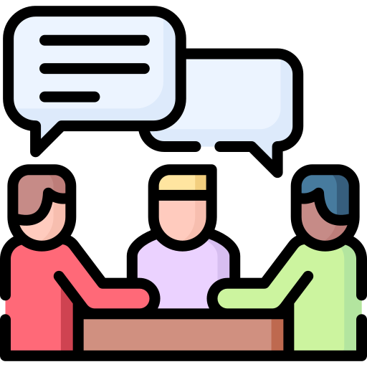
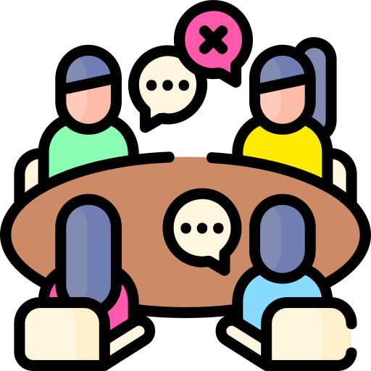
Provide a convenient way to participate in the society
Restore the ability to mix with the environment
Notes:
We decided to develop an app that helps those patients and overcome other apps' cons
Our app is a way to improve pronunciation, communication and the ability to remind both object, friends and family members.
Our application is developed as a rehabilitation tool for stroke, Alzheimer and speech-impaired patients.

Slide 18
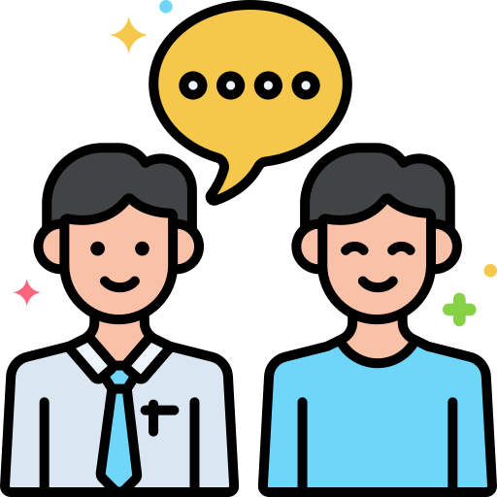
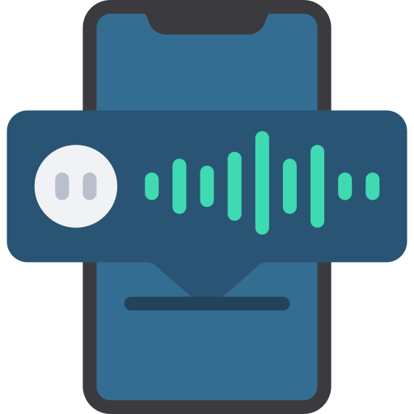
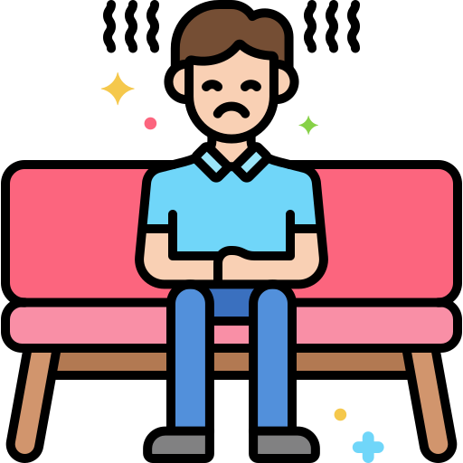
We developed an application that satisfies our main targets
Notes:
We decided to develop an app that helps those patients and overcome other apps' cons
Our app is a way to improve pronunciation, communication and the ability to remind both object, friends and family members.
Our application is developed as a rehabilitation tool for stroke, Alzheimer and speech-impaired patients.

Slide 19
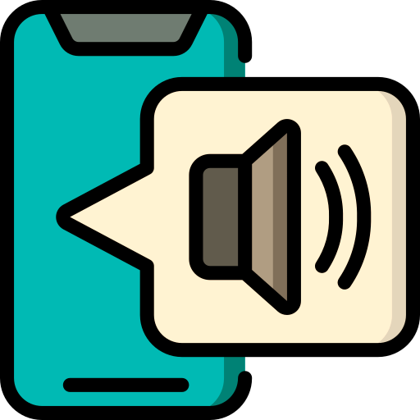

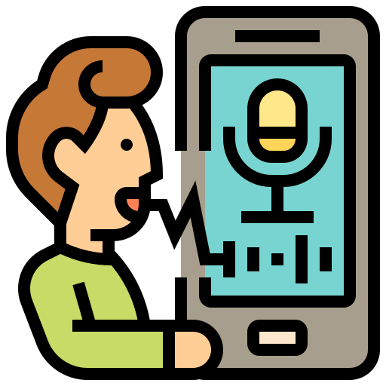
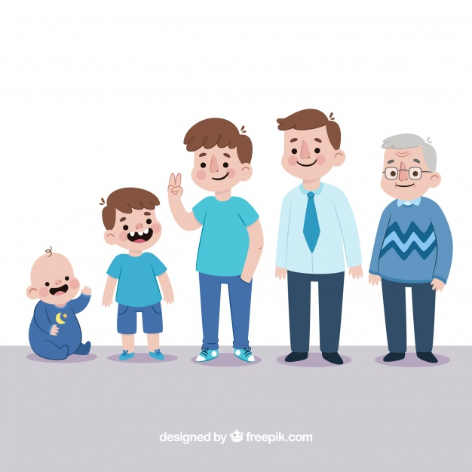

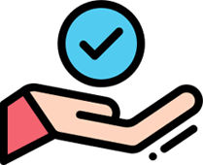
voice & image to create sentences
speech verification to improve pronunciation
Easy user interface
multimedia capability
supporting Arabic as a basic language
Notes:
combining voice and image to create sentences
speech recognition to improve pronunciation
simple user interface for different ages (متغير يناسب جميع الاعمار) => (multimedia capability)
supporting Arabic as a basic language. It can also be applied in foreign languages

Slide 20
APP Structure and Services
Problem
Solutions
App
Method
Future

Slide 21
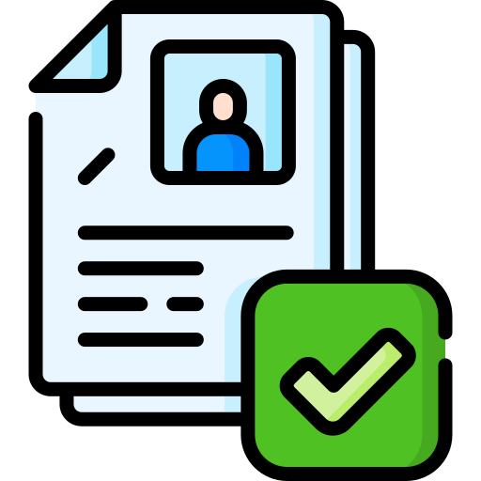
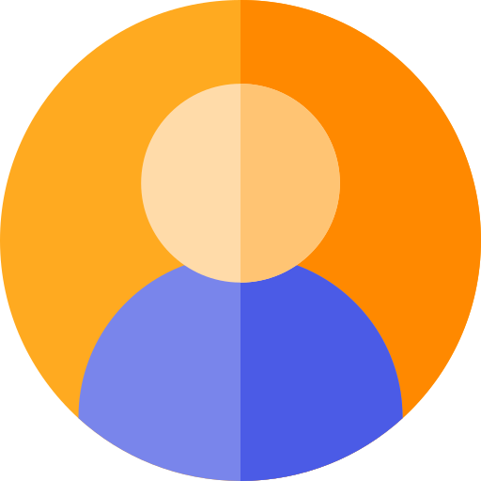
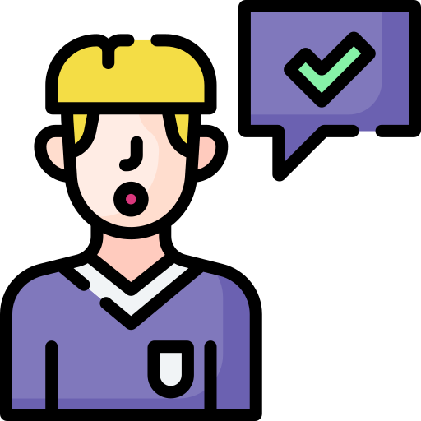
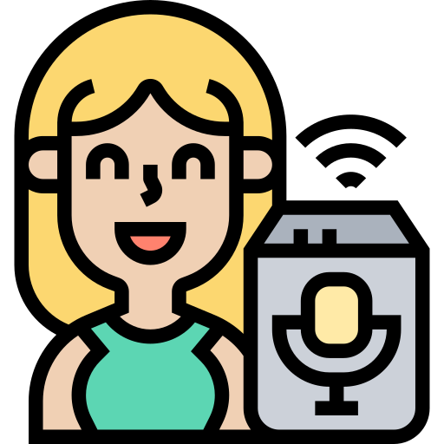
Registeration تسجيل الدخول
Personal Information and progress
الملف الشخصي
Select, listen, and
repronounce
المدرب
المساعد
form sentence and listen
Notes:
After Registeration
Personal Information Including Age, Gender, History of Progress Since the Creation of the account
Select some words to make the user listen to and re-pronounce it to score his progress
Help the user to form different phrases that he can’t speech and also recognize different objects
بعد تسجيل الدخول فهو بيتكون من تلات اجزاء رئيسيه و هنتكلم عن كل واحده بالتفصيل و هما 1- الملف الشخصى 2- المدرب 3- المساعد

Slide 22
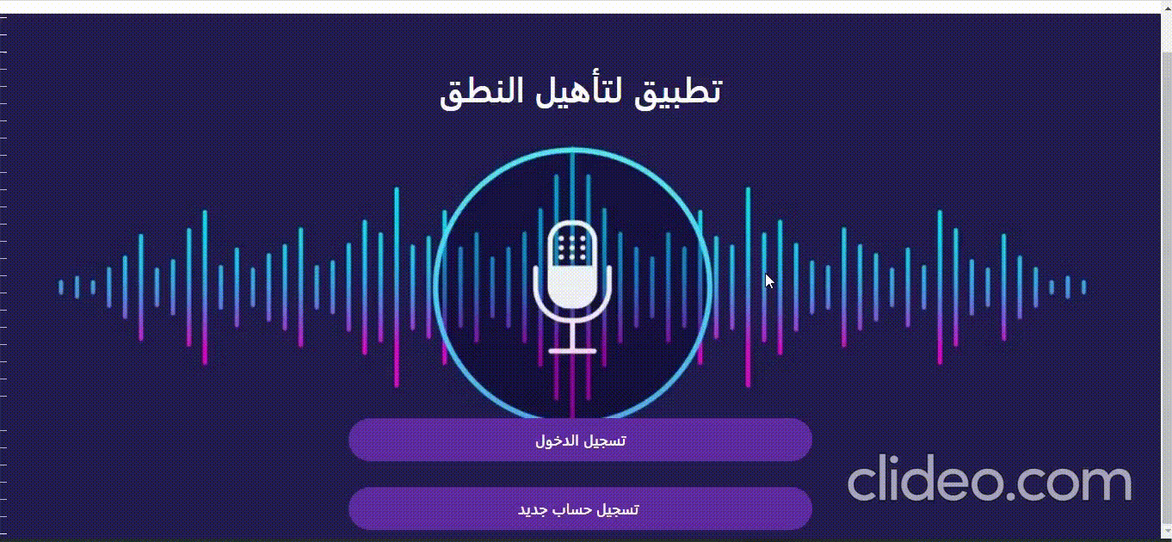
Registeration تسجيل الدخول
Notes:
After Registeration
Personal Information Including Age, Gender, History of Progress Since the Creation of the account
Select some words to make the user listen to and re-pronounce it to score his progress
Help the user to form different phrases that he can’t speech and also recognize different objects
بعد تسجيل الدخول فهو بيتكون من تلات اجزاء رئيسيه و هنتكلم عن كل واحده بالتفصيل و هما 1- الملف الشخصى 2- المدرب 3- المساعد

Slide 23
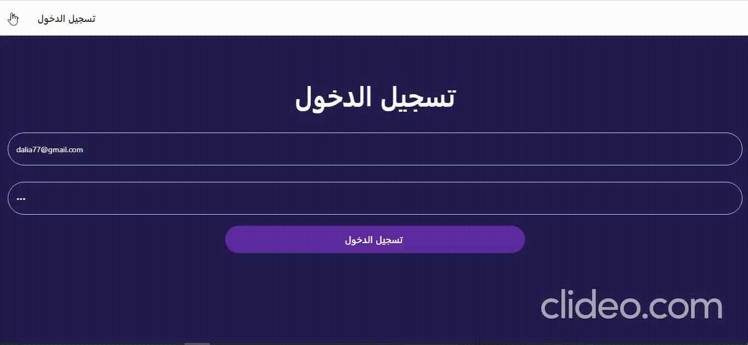
Registeration تسجيل الدخول
Notes:
After Registeration
Personal Information Including Age, Gender, History of Progress Since the Creation of the account
Select some words to make the user listen to and re-pronounce it to score his progress
Help the user to form different phrases that he can’t speech and also recognize different objects
بعد تسجيل الدخول فهو بيتكون من تلات اجزاء رئيسيه و هنتكلم عن كل واحده بالتفصيل و هما 1- الملف الشخصى 2- المدرب 3- المساعد

Slide 24


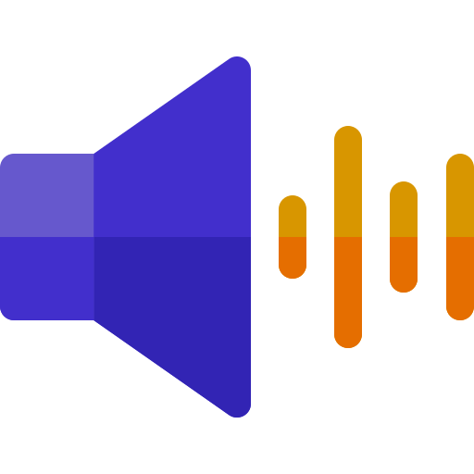
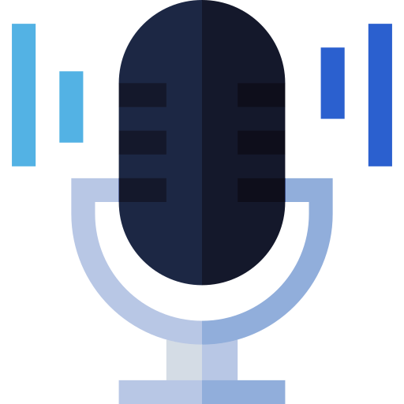
Coach المدرب
قلم
Word to practice on
Listen to reference, record and replay
الكلمه التقييم
كرسى 66%
قلم 68%
Your Score through the session

Slide 25
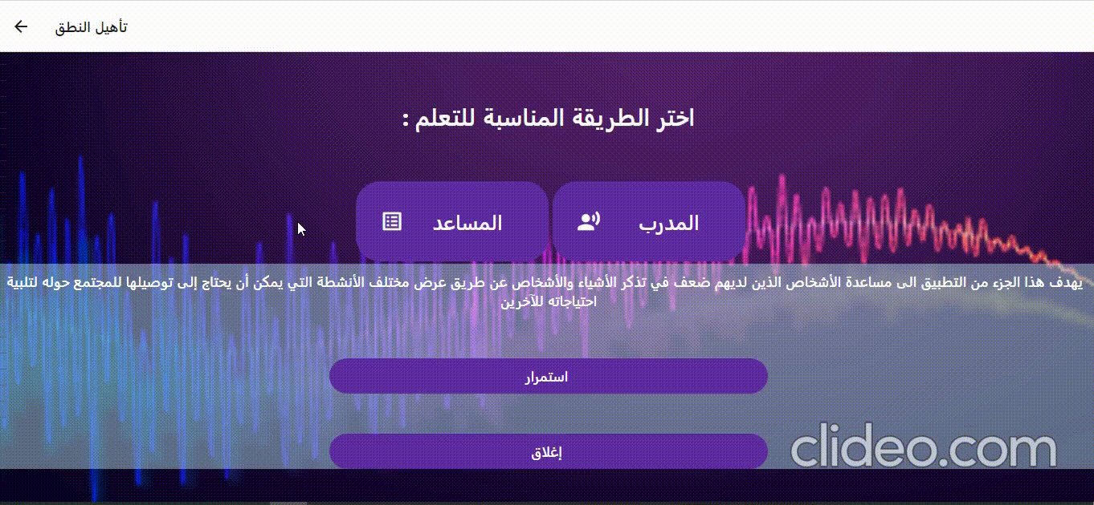
Coach المدرب

Slide 26
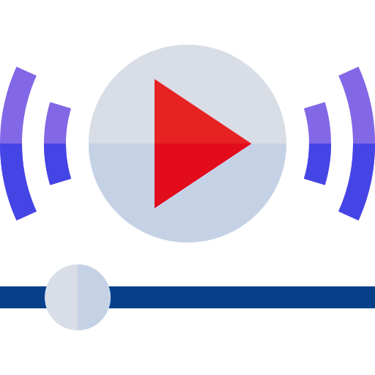



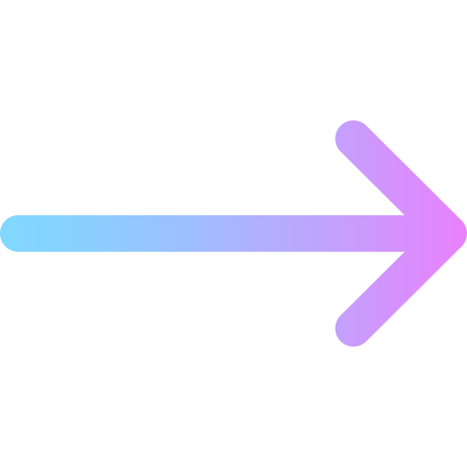


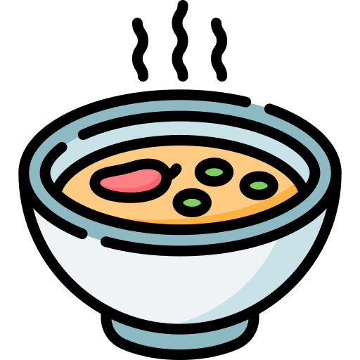

Assistant المساعد
انا اريد ...
Form Sentence
أنشطه
طعام
Select Category
لحم
شوربه
خبز
Choose Word

Slide 27

Assistant المساعد

Slide 28

Profile الملف الشخصى
Personal Data
بيانات شخصيه
التطور الاسبوعى
Personal Progress

Slide 29


Profile الملف الشخصى
Doctor View
Patient View

Slide 30

Tablet App
انا اريد ...
قلم
الكلمه التقييم
كرسى 66%
قلم 68%
أنشطه
طعام
أشياء

Slide 31
Desktop Software
انا اريد ...
قلم
الكلمه التقييم
قلم 68%
أنشطه
طعام
أشياء

Slide 32
Market & Stakeholders
Problem
Solutions
App
Method
Future

Slide 33

The Market
Notes:
The global voice and speech recognition market size was valued at USD 14 billion in 2021 and is anticipated to grow at a compound annual growth rate (CAGR) of 15% from 2022 to 2030.
So The growing use of voice biometrics is among the major factors driving the market growth and the use of mobile applications in speech therapy is also growing as an avenue to bring treatment into the home.

Slide 34


The Stakeholders
The target customers for our application are mainly
Mainly patients who suffer from speech impairment
Speech therapists
Hospitals and any healthcare facility providing speech therapy sector
أاا .. م
Notes:
the target customers for our application are mainly patients who suffer from speech impairment like (Aphasia, Apraxia, Articulation disorders, Alzheimer, Cognitive-communication disorders, Dysarthria, etc.), speech therapists, hospitals and any healthcare facility providing speech therapy sector.

Slide 35
Used Tools
Problem
Solutions
App
Method
Future

Slide 36


IDE
Notes:
Mainly we are using vs code ide beside some tools facilitating working with python like jupyter and anaconda

Slide 37




Audio Processing
Notes:
For building our functions and dealing with audio files we used some python libraries such as librosa, pydub, matplotlib, and numpy

Slide 38




Front-End
Notes:
For building our UI we used html, css, js frameworks react for website and react native for mobile app beside using android studio ide as emulator for our mobile

Slide 39


Back-End
Notes:
For backend we created server flask app and mysql database

Slide 40
How this is developed ?
Problem
Solutions
App
Method
Future

Slide 41
Our App is mainly divided into two parts
Coach المدرب
Assistant المساعد

Slide 42







Coach المدرب
Extracting features for speech verification
Recording Audio File & storing it.
Construction of Web & Mobile App
STEP
1
STEP
2
STEP
3
STEP
4
STEP
5
Audio Preprocessing
DYNAMIC TIME WARPING & Similarity Matching

Slide 43








Recording Audio File & storing it
Here we started by collecting random word records for patients to practice on such as persons names and objects that he deals with daily
سكينه
مصطفى
فستان
ساره
سرير
اشرب
على
كرسى
Notes:
Here we started by collecting random word records for patients to practice on such as persons names and objects that he deals with daily

Slide 44


Preprocessing
Normalization: scaling the signals in identical level
Original Audio
Normalized Audio
Notes:
Sometimes you'll have audio files where the speech is loud in some portions and quiet in others. Having this variance in volume can hinder transcription. We need to normalize a signal when we want to compare it with respect to other signals. Normalization means scaling the signals in identical level. It is a rescaling of the data from the original range so that all values are within the range of 0 and 1. If you normalize the signals in power level, that means all the signals have same power now

Slide 45


Preprocessing
Silence Removal: trim leading and trailing silence from an audio signal
Notes:
We can use librosa.effects.trim() function from librosa library to remove silence from the signal. It will trim leading and trailing silence from an audio signal. After reading the audio file and converting it into frames, it checks voice activity detector VAD to each set of frames using Sliding Window Technique. The Frames having voices are collected in separate list and non-voices(silences) are removed. Hence, all frames which contain voices is in the list are converted into “Audio file”.‏

Slide 46

Feature Extraction
Short-Time Energy &Zero crossing Rate
Amplitude
Amplitude
Time
Notes:
The energy of a signal corresponds to the total magnitude of the signal. For audio signals, that roughly corresponds to how loud the signal is
Short time zero crossing rate is the number of times the speech signal changes sign within a given time window(Frame)
In other words, it is the number of times the signal changes value, from positive to negative and vice versa, divided by the length of the frame. measure of the noisiness of a signal. For example, it usually exhibits higher values in the case of noisy signals. Frame size : 1024sample
Hop length :1/3 or ½ Frame size
44100/1024 =0.022 msec
Vowel phoneme has high energy with less frequency
Consonant phoneme has less energy with high frequency

Slide 47


Feature Extraction
Mel-Frequency Cepstral Coefficients (MFCCs)
MFCC Feature
MFCC Coefficients
Time(s)
Notes:
It is the most widely used feature in speech and music classification applications. Different sounds can be easily classified by using MFCCs because of its discriminative ability
Btl3 mnha coeff nm 8-13
The output after applying MFCC is a matrix having feature vectors extracted from all the frames.
rows represent the corresponding frame numbers and columns represent corresponding feature vector coefficients
Finally this output matrix is used for classification process
Centroid:center of mass of signal (weight of the signal)
Roll off : max,min
Chroma : tonal content high level semantic analysis

Slide 48

Dynamic time warping(DTW)
Amplitude
Time
Notes:
Dynamic time warping (DTW) is an algorithm for measuring similarity between two temporal sequences, which may vary in speed. any data that can be turned into a linear sequence can be analyzed with DTW. A well-known application has been automatic speech recognition, to cope with different speaking speeds.
Zy mashayfeen hwa by3ml matched pair between two signals with minimal cost(sum of absolute differences)
W bytl3 el similarity between two alignments dol

Slide 49


Dynamic time warping(DTW)
مص
طفى
Amplitude
Reference Audio
Amplitude
مصطفى
Time
Recorded Audio
Notes:
Similarity matching

Slide 50




Design and Implementation
Database System
(secure and retrievable)
User Interface
(easy and convenient for all ages)
Notes:
Finally, we worked on designing the Database System to be secure and retrievable in no time
also, we searched to decide how to provide an easy and simple user interface that is convenient for all ages and we started to implement it

Slide 51

Assistant المساعد
Forming complete sentences
Database Collection
STEP
1
STEP
2
STEP
3
STEP
4
Categories Separation
GUI design and Implementation

Slide 52











Recording & Categorization
كلمات
مطبخ
طعام
انشطه
اشخاص
غرف
ملابس
طبق
خبز
اريد
على
سرير
فستان
سكينه
شوربه
آكل
ساره
مرآه
تيشيرت
كوب
لحمه
اشرب
هشام
كرسى
حذاء
Notes:
Here we started increasing the number of recorded words to include the minimum number of words that he deals with in his daily life
also, we categorized these words to enable the patient to choose words from different categories to be able to form a convenient sentence that enables him to express his needs and deal with the environment easily
We have collected records about 11 category, with about 4500 record from different ages males and females

Slide 53
Design and Implementation
Database System Categorization
(secure and retrievable)
Graphics User Interface
(easy and convenient for all ages)
Notes:
Finally, we worked on designing the Database System to be secure and retrievable in no time
also, we searched to decide how to provide an easy and simple user interface that is convenient for all ages and we started to implement it

Slide 54
Demo from our application
Problem
Solutions
App
Method
Future

Slide 56
Challenges & Time Mapping
Problem
Solutions
App
Timing
Future

Slide 57
Challenges
Database
Similarity
80%
70%
Status: Ongoing
Status: Ongoing
UI Implementation
UI Design
100%
100%
Status: Finished
Status: Finished

Slide 58

Challenges
Database Collection
Similarity Matching
We have collected records about 12 category, with about 4500 record from different ages males and females.
Noise & Filteration
Normalization & Energy Level
Silence Removal
Similarity Accuracy

Slide 59
Time Map
Audio signal loading and studying
DTW and similarity index
Ui design and implementation
Integrating system parts
App feedback
Oct
Nov
Dec
Jan
Feb
Mar
Apr
May
Jun
Feature extraction and selection
Database collection and testing
System Deployment and launch
Accuracy inhanecment

Slide 60

Time Map

Slide 61
SWOT Analysis & Future Work
Problem
Solutions
App
Awards
Future

Slide 62






STRENGTHS
WEAKNESSES
OPPORTUNITIES
THREATS
Support Arabic language
Benefits both patient and therapist
Help shy children
Cost effectiveness
Easy to use
application accuracy
Limited database
Less reliable if voice changes in time of distress.
speech and voice recognition market growth
effective dataset
emotional human element
Integrating with google assistant
Lack of trust
Being less effective in speech therapy than traditional offline used techniques
Potential copycats
Notes:
The first application to Support Arabic language as basic language in speech recognition field.
Increase the number of patients the speech therapist can receive a day.
Decrease the number of offline speech therapy sessions for every patient.
Save a lot of time for both of the therapists and patients.
It can help children who are shy and do not like to talk to people they don't know
Cost effectiveness.
The application accuracy still low and need to be improved.
Limited database of the application.
Less reliable if voice changes in time of distress.
Applying this technology will drive the speech and voice recognition market growth in Egypt.
Using more effective techniques for creating the reference dataset will increase the accuracy of the application.
Adding an emotional human element to the design
Development of the application to support the Arabic language for other Arab countries
Integrating with google assistant to provide a more recognizing system for people with speech impairment
Development of the application to provide group therapy services.
Applying more advanced machine learning algorithms to improve accuracy of the application.
Updating the application continuously and increasing features to meet customer needs.
Lack of trust
Being less effective in speech therapy than traditional offline used techniques.
Potential copycats

Slide 63



Personal Dictionary
اضافة كلمات
We are working on adding a new feature to our application that enables the user, supervising doctor, or family members to add new words
Practice
Form Sentence
Remember
Notes:
We are working on adding a new feature to our application that enables the user, supervising doctor, or family members to add new words
these words would help the patient to practice some specific words that he has problems with
also, these words can be personal such as some objects or family members to that patient to be remembered
besides some words specific to that patient to be contained in his daily sentences

Slide 64





Progress Review
تقييم الحاله
Here we want to enable the doctor to add and send a review of his patients' progress and be able to evaluate personally the case of each patient
Add prescription
Evaluation
Communicate
Notes:
Here we want to enable the doctor to add and send a review of his patients' progress and be able to evaluate personally the case of each patient based on listening to his previous records so he can decide if this patient needs more practice or to add some specific words to practice on

Slide 65
Awards
Problem
Solutions
App
Awards
Future

Slide 66


Participated in: ITIDA, The 2022 International Science and
Engineering Innovations Competition(ISEIC'2022), dell
Passed: ISEIC'2022 competition final stage
Notes:
We have participated in many competitions and supporting programs such as ITIDA, The 2022 International Science and Engineering Innovations Competition(ISEIC'2022), and dell.
And we have passed the final stage in ISEIC'2022 competition

Slide 67


Notes:
We have participated in many competitions and supporting programs such as ITIDA, The 2022 International Science and Engineering Innovations Competition(ISEIC'2022), and dell.
And we have passed the final stage in ISEIC'2022 competition

Slide 68

Notes:
We have participated in many competitions and supporting programs such as ITIDA, The 2022 International Science and Engineering Innovations Competition(ISEIC'2022), and dell.
And we have passed the final stage in ISEIC'2022 competition

Slide 69
Questions ?
Problem
Solutions
App
Awards
Conclution

Slide 70
Thanks
Problem
Solutions
App
Awards
Conclution

Slide 71

Feature Extraction
Mel-Frequency Cepstral Coefficients (MFCCs)
Notes:
1-Take the Fourier transform of (a windowed excerpt of) a signal.
2-Map the powers of the spectrum obtained above onto the mel scale, using triangular overlapping windows or alternatively, cosine overlapping windows.
3-Take the logs of the powers at each of the mel frequencies.
4-Take the discrete cosine transform of the list of mel log powers, as if it were a signal.The MFCCs are the amplitudes of the resulting spectrum.

